Slide 1
Data Visualization of Bird Strikes between 2000 - 2011
By Sakshi Sanjeeva Hegde
UNID: UMIP8273

Slide 2
Introduction
Transport and communication are in the crucial domain in the field of analytics. Environmental impacts and safety are, nowadays, two major concerns of the scientific community with respect to transport scenarios and to the ever-growing urban areas. These issues gain more importance due to the increasing amount of vehicles and people. Seeking new solutions is reaching a point where available technologies and artificial intelligence, especially MAS, are being recognized as ways to cope with and tackle these kinds of problems in a distributed and more appropriate way.
A bird strike is strictly defined as a collision between a bird and an aircraft which is in flight or on a take-off or landing roll. The term is often expanded to cover other wildlife strikes - with bats or ground animals. Bird Strike is common and can be a significant threat to aircraft safety. For smaller aircraft, significant damage may be caused to the aircraft structure and all aircraft, especially jet-engine ones, are vulnerable to the loss of thrust which can follow the ingestion of birds into engine air intakes. This has resulted in several fatal accidents.

Slide 3
Problem Statement and Case Studies:
Bird strikes may occur during any phase of flight, but are most likely during the take-off, initial climb, approach and landing phases due to the greater numbers of birds in flight at lower levels. To have a closer look the following document visually depicts the data collected on Bird Strikes by FAA between 2000-2011.
Case Studies:
Visuals Depicting the Number of Bird Strikes
Yearly Analysis & Bird Strikes in the US
Top 10 US Airlines in terms of having encountered bird strikes
Airports with most incidents of bird strikes – Top 50
Yearly Cost Incurred due to Bird Strikes:
When do most bird strikes occur?
Altitude of aeroplanes at the time of strike
Phase of flight at the time of the strike.
Average Altitude of the aeroplanes in different phases at the time of strike
Effect of Bird Strikes & Impact on Flight
Effect of Strike at Different Altitude
Were Pilots Informed? & Prior Warning and Effect of Strike Relation

Slide 4
Methodology:
Import data into python for data pre-processing and cleaning.
Then saved the data frame as a new excel sheet
Used Tableau for Visualization purposes
Then finally created dashboards comprising of cased studies related to Bird Strike in USA

Slide 5
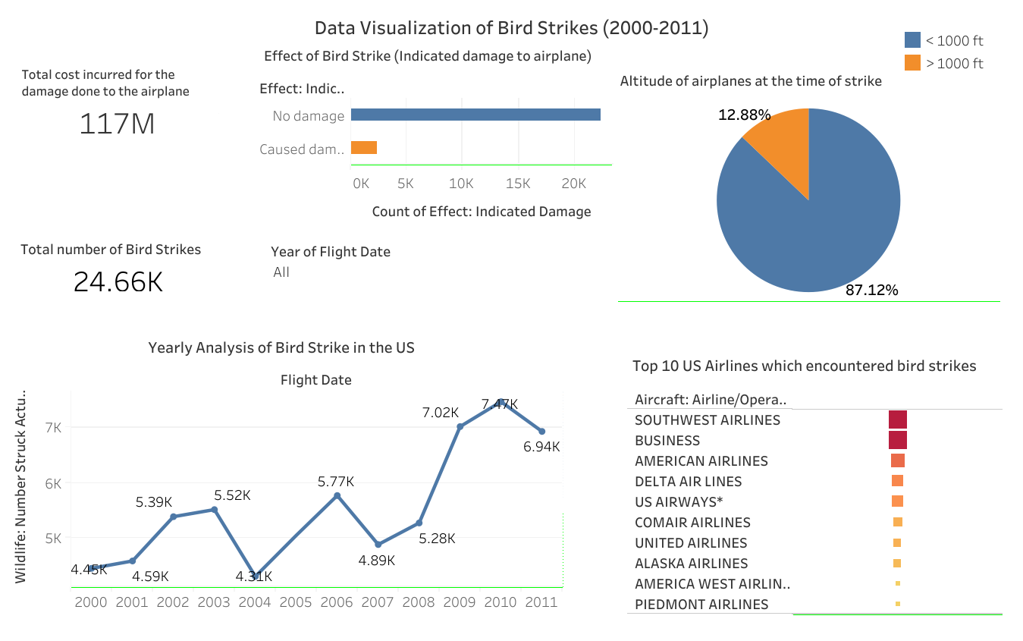
Dashboard -1

Slide 6
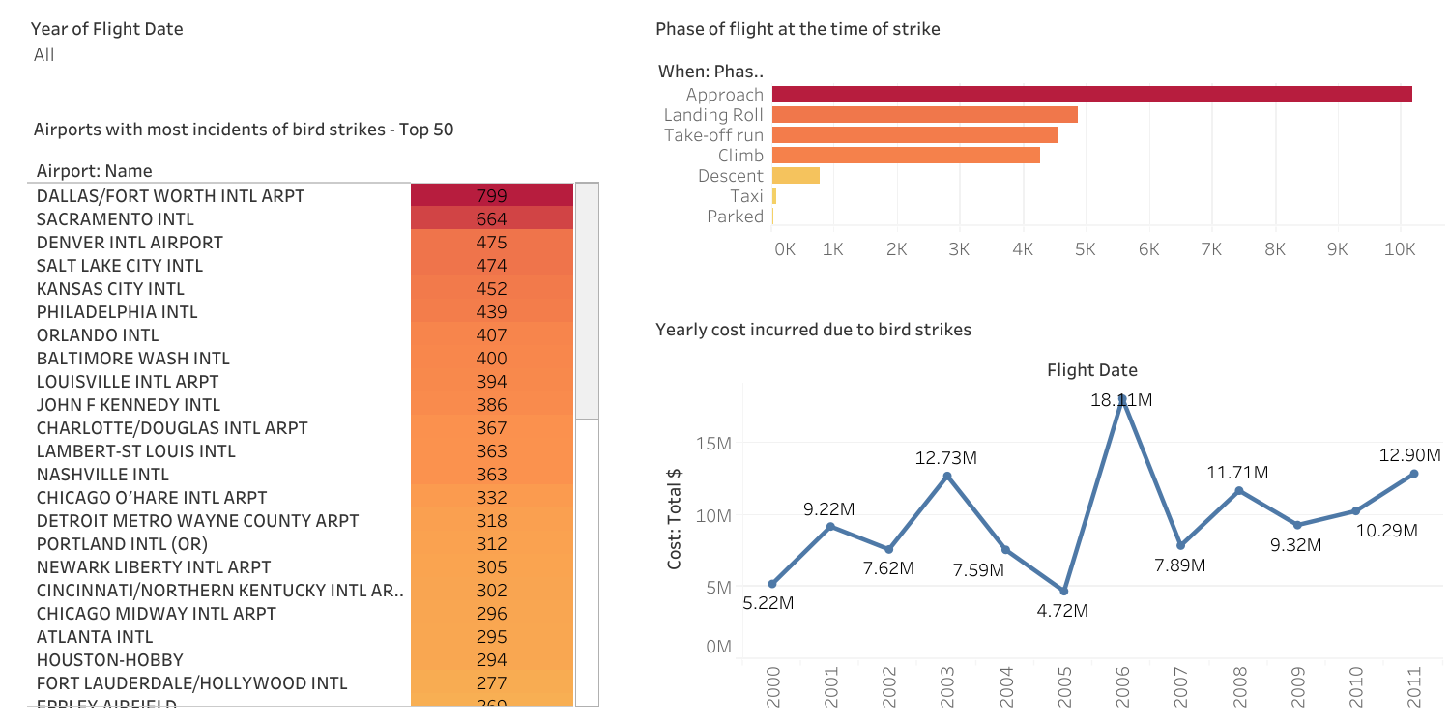
Dashboard - 2

Slide 7
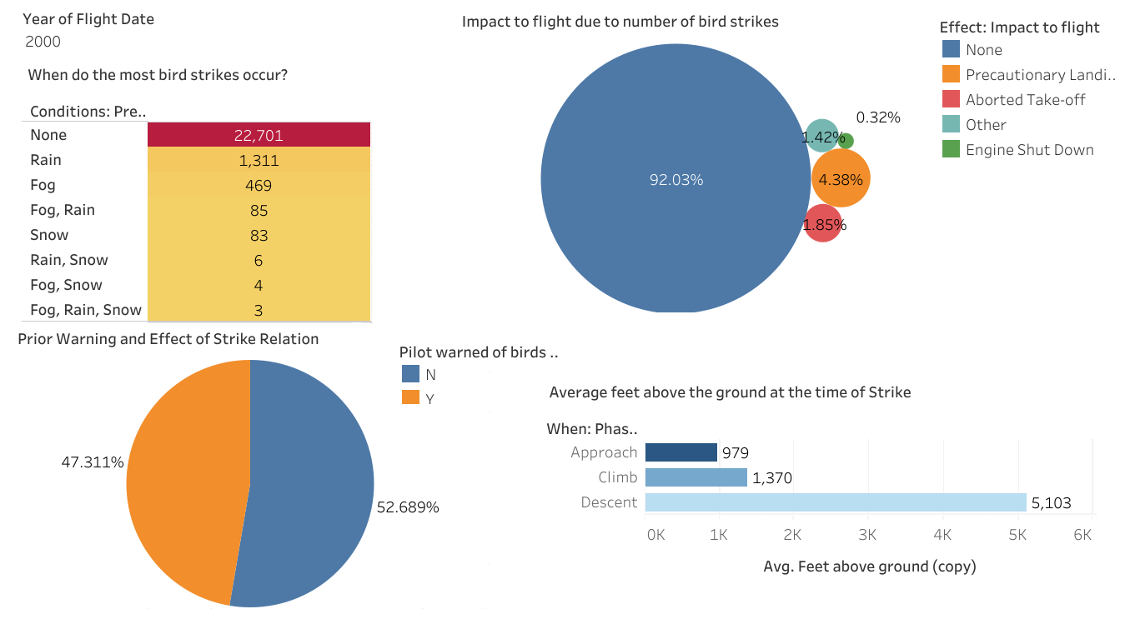
Dashboard - 3

Slide 8
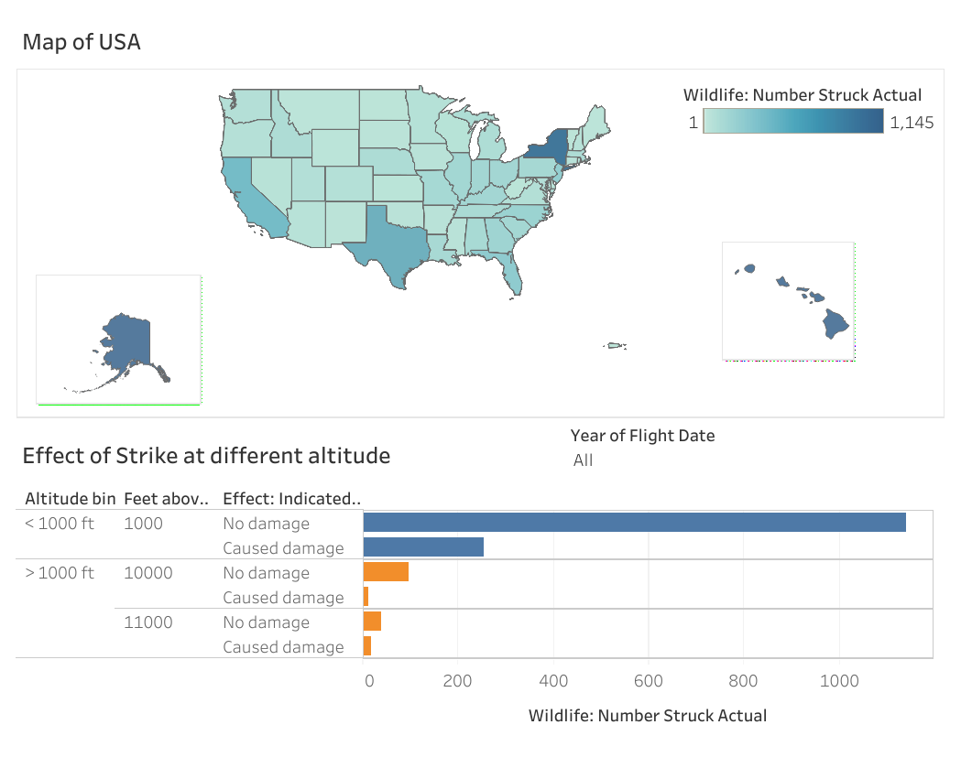
Dashboard - 4

Slide 9
Findings:
Through visual analysis I observed that the Bird Strike incident was increasing since 2008 then there was a drop in 2011.
The total number of bird strike occurred from 2000 to 2011 is 24.66K at the airports of USA.
Dallas international airport which is in Texas ranks the highest under Top 50 which encountered 799 incident related to bird strike and Jacksonville international airport which encountered 154 incident related to bird strike from 2000-2011.
Under top 10 airlines which encountered the most bird strike incident, Southwest airlines ranks the most and Piedmont airline ranks the lowest.

Slide 10
The total cost incurred for the damage done to airplane is 117 million dollars
The most strike occurred during the clear weather conditions and during the approach of the flight to airport, the number of strikes is 10k and followed by landing roll.
87.12% of the strike happened when the flight is less than 1000 feet above the ground and 12.88% of the strike happened when the flight is greater than 1000 feet above the ground.
Average feet above the ground when strike occur during approach is 979 feet which is less than 1000 feet.

Slide 11
My research analysis (Conclusion)
Most birds fly below the 1000 feet above the ground
Through analysis I found out that bird strike happens usually during clear weather conditions, as birds tend to migrate to places where the weather is clear. So, therefore, there is more strike during ‘none’ weather conditions
Since the Dallas airport rank the most and bird strike happens during fall months and dallas is located in texas. So, in texas, the birds tend to migrate to this state as the heavy rainfall do not occur during fall months. But rainfall often occurs during spring months (March-May) in Texas.
Hence, the bird strike observed to be more in Summer and Fall months. As they migrate to places during these seasons for clear weather conditions.

Slide 12
Reference:
https://www.sciencemill.org/blog/2023/9/23/why-is-texas-important-to-bird-migration#:~:text=Birds%20that%20nest%20in%20the,better%20resources%20in%20the%20south.

Slide 13
Thank You

